Slide 1
Spanish-American War
April 1898-August 1898

Slide 2
Spanish and Cuban relations pre-war
For more than 300 years Cuba and Philippines belonged to Spain
Brought Spain wealth
Revolts occasionally occurred, but not until the 1890s did they seriously threaten Spanish control

Slide 3
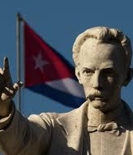
Cuba and Spain go to war
Cuban people struggled for independence from Spain since 1868
1895 Cuban rebels led by José Martí renewed their fight for independence
Spain forced 300,000 Cubans into concentration camps—thousands died

Slide 4
US Government POV
William McKinley, President in 1896—supported independence but had no desire for war with Spain
1897 McKinley took encouragement from a new Spanish government that promised reforms in Cuba as well as some independence

Slide 5
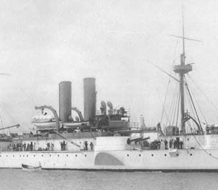
February 1898, explosion blew up the battleship Maine, killing 260 officers
Media headlines screamed for revenge, blaming Spain

Slide 6
President vs. congress views
April 1898, President McKinley sent message to Congress that called for use of troops to bring about “a national compromise between the contestants.”
Congress responded with a more warlike statement, giving the President authority to use troops to end Spanish control and declare Cuba independent

Slide 7
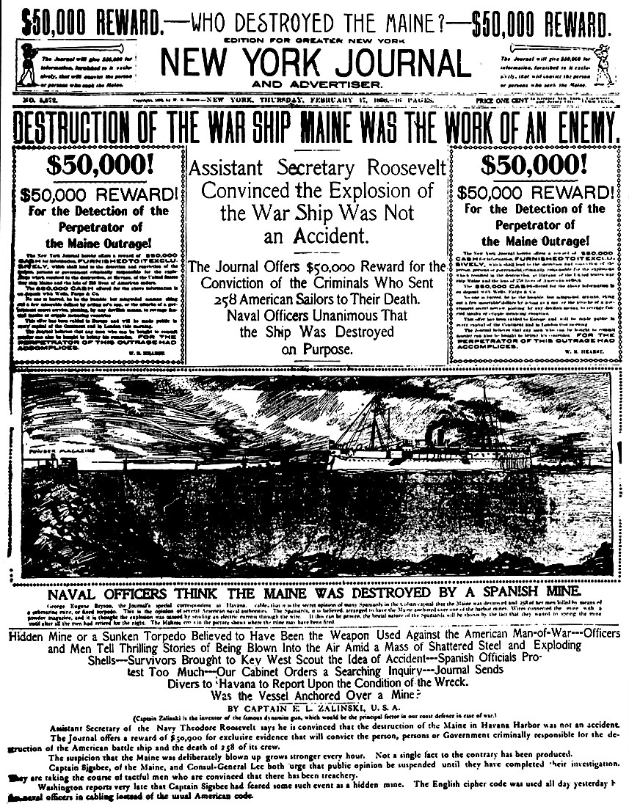
Yellow journalism
Journalism that sensationalized—and sometimes even manufactured—dramatic events
Helped propel the US into war with Spain
Used melodrama, romance, and hyperbole to sell millions of newspapers

Slide 8
Yellow journalism & the war
Journalists, with their sensational headlines and stories, pressed politicians into declaring war after the explosion of the Maine.
    Sold a lot of newspapers!!!
In 1975, a study of the sinking concluded that an accident, probably a faulty boiler, caused the explosion

Slide 9
Ending the war
August 12, 1898, this short war ended; a treaty was negotiated:
    Spain granted independence to Cuba
    Ceded Guam, Puerto Rico, and the Philippines to the US in exchange for $20 million
US did not annex Cuba due to the Teller Amendment (April 1898), which had promised not to annex Cuba, as a compromise for some in Congress who were hesitant to declare war
1901 Platt Amendment: effectively limited Cuban independence and made Cuba a U.S. “protectorate” -- a country controlled by the U.S. under the guise of “protection

Slide 10
United states and the Philippines
US claimed it was fighting to liberate the Philippines, but refused to give independence after the Spanish American war
President McKinley argued that Filipinos were “unfit for self government” He feared “anarchy” and vowed to “educate,” “uplift,” and “civilize” population
Business interests motive--Philippines provided a rich variety of natural resources as well as a foothold in the valuable Asian trade markets

Slide 11
War with the Philippines
The Filipino revolutionaries, led by Emilio Aguilnado, had welcomed the U.S. as liberators in their fight against Spain
Now they felt betrayed and refused to accept US annexation of the Philippines
The US and the Philippines fought a guerilla war until 1906
The US did not grant the Philippines full independence until 1946.

